Slide 1


YouTube Songs Analysis
By Adepegba David .a.

Slide 2

Table of Contents
- Problem Statement - Dataset Description - Data Cleaning - Data Visualization - Insight
By Adepegba David .A.

Slide 3

Problem Statement:
This project aims to conduct a comprehensive analysis of YouTube songs data using Power BI.
The goal is to utilize Power BI to create insightful visualizations and reports that provide a deeper understanding of YouTube songs' performance, popularity, and user engagement.
The analysis aims to uncover trends, preferences, and patterns in the data to aid content creators and stakeholders in optimizing their YouTube song content.

Slide 4
Dataset Description:
VIDEO_ID: Unique identifier for each YouTube video.
CHANNELTITLE: Title of the YouTube channel publishing the song.
TITLE: Title of the YouTube song video.
DESCRIPTION: Description provided for the YouTube song video.
TAGS: Tags associated with the YouTube song video.
PUBLISHEDAT: Date and time when the YouTube song video was published.
VIEWCOUNT: Number of views received by the YouTube song video.
LIKECOUNT: Number of likes received by the YouTube song video.
FAVORITECOUNT: Number of times the YouTube song video has been marked as a favorite.
COMMENTCOUNT: Number of comments posted on the YouTube song video.
DURATION: Duration of the YouTube song video.
DEFINITION: Video definition or quality (e.g., HD, SD).
CAPTION: Availability of captions for the YouTube song video.

Slide 5
Data Cleaning:
Utilizing filter buttons and other tools, eliminate outliers and missing values.
Convert relevant columns to appropriate data types.
In Microsoft Excel, use the upper function to change the headers to uppercase.
Delete the columns that aren't relevant to the analysis.
The music title can be retrieved from the title header by using text to Column.
The dataset comprises 14 rows and 19,345 columns in total. After cleaning the data, I was left with 10 columns and 19,322 rows for my analysis.

Slide 6
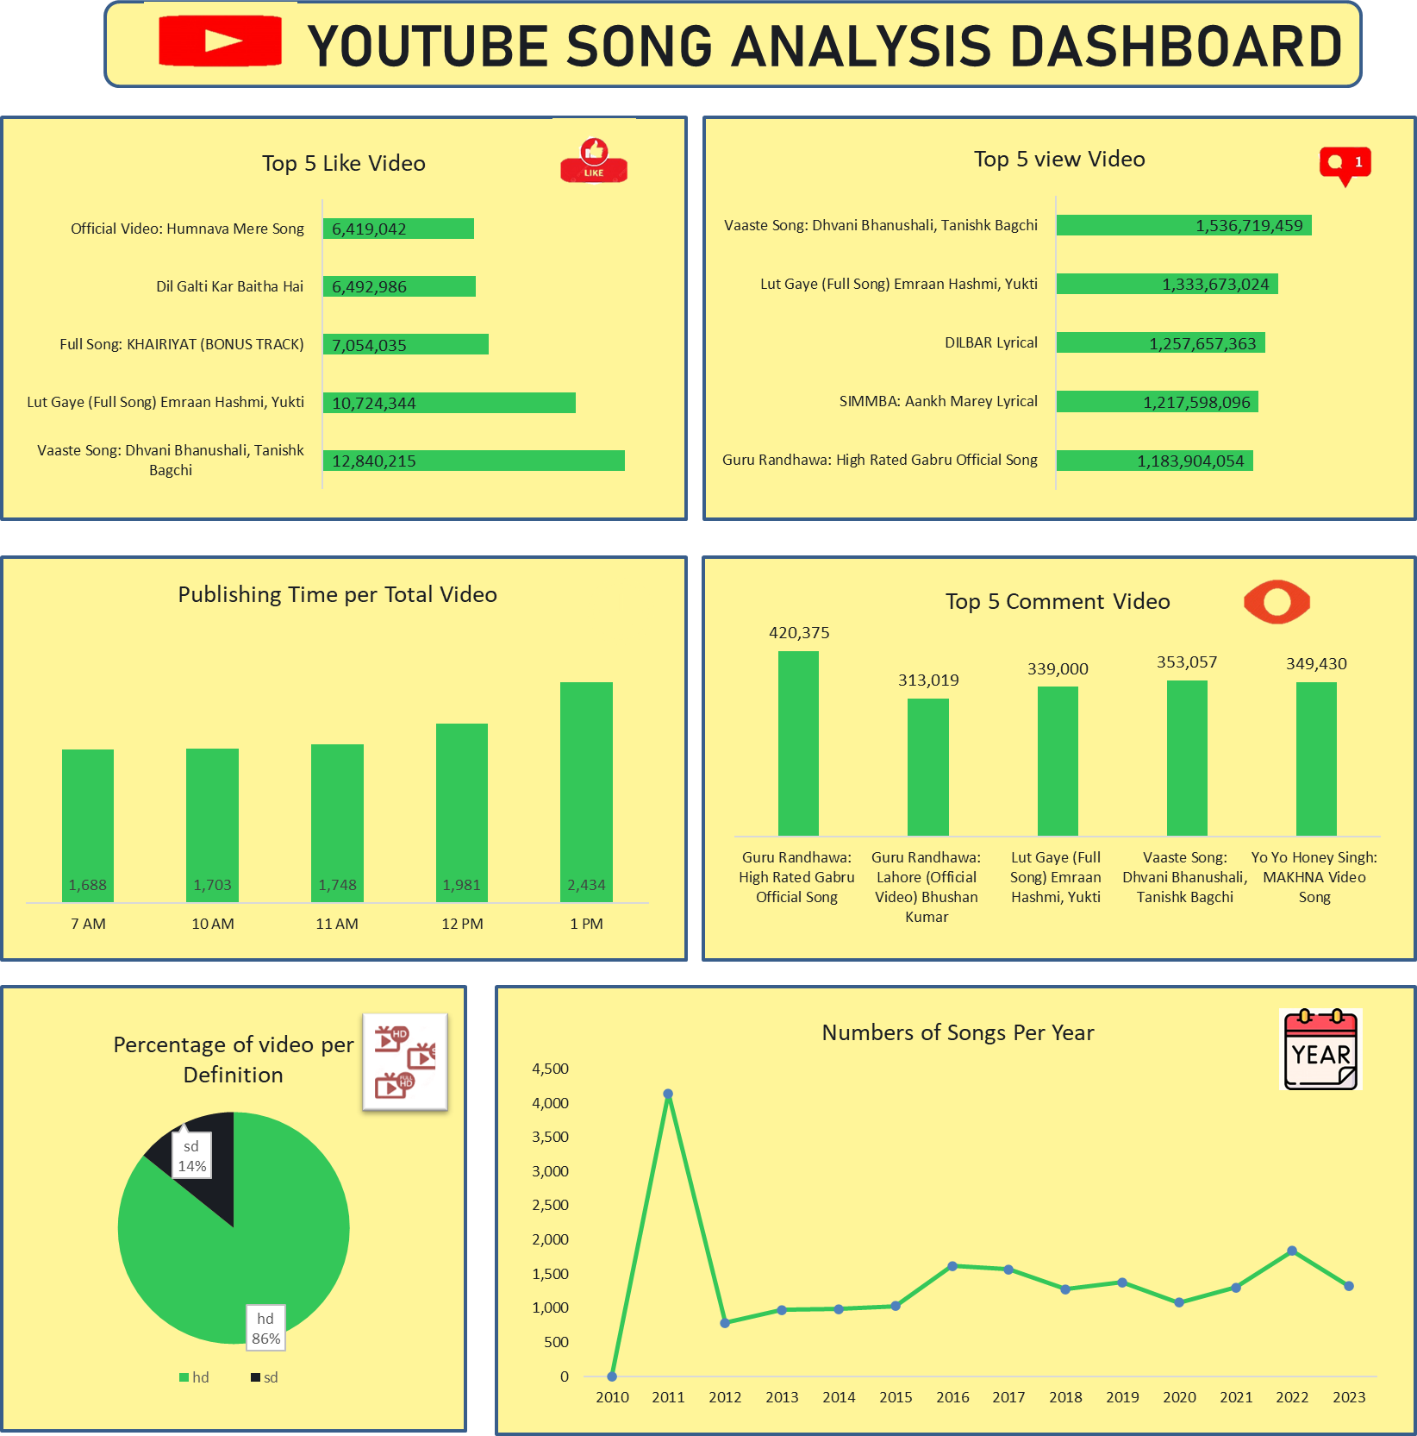
Data Visualization

Slide 7



Insight:
With more than 12.8 million likes, the most popular video is "Vaaste Song: Dhvani Bhanushali, Tanishk Bagchi."
"Guru Randhawa: High Rated Gabru Official Song" is the video with the most comments, at 420,375.
Top view video is “Vaaste Song: Dhvani Bhanushali, Tanishk Bagchi “ with more than 1.5billions views.

Slide 8




Insight:
The percentage of HD video is 86%, compared to 14% for SD.
2011 was the year with the highest production, with 4,142 songs created.
At 13:00, 2,434 songs reach their peak publishing time.
The correlation coefficient between "like count" and "view count" is 0.906968.

